Slide 1
Predicting remaining useful life of turbofan engines
Infrastructure Diagram and Model Explainability

Slide 2
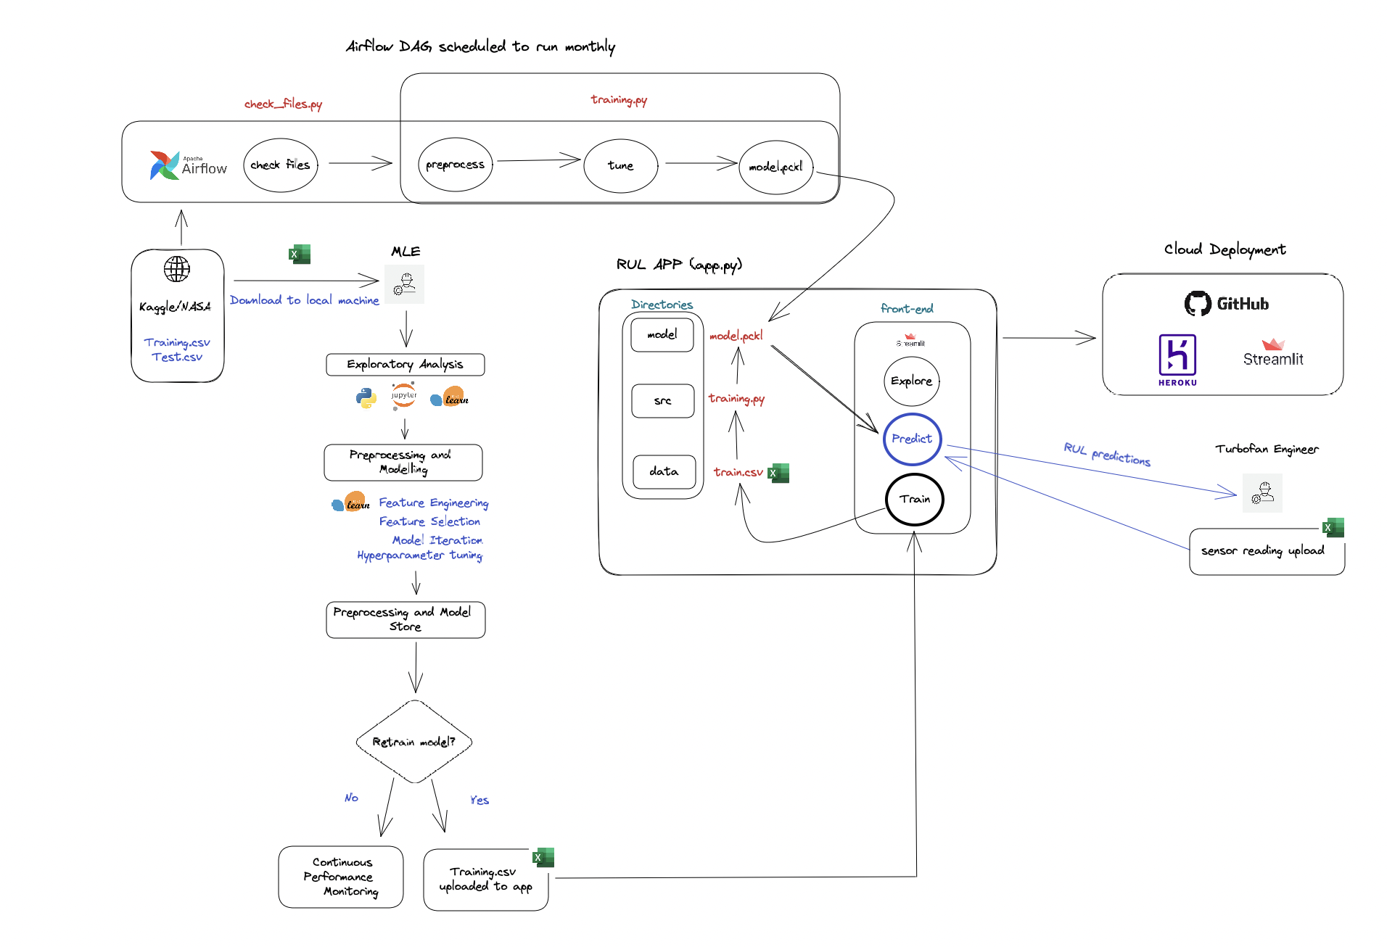
INFRASTRUCTURE DIAGRAM
https://excalidraw.com/#json=g9RBQNyOCyXaJiW1QyLsY,kcjMP5_OhWzlYWk45xgQaQ

Slide 3
MODEL EXPLAINABILITY
One drawback of machine learning models is that they are inherently difficult to explain in terms of causality, i.e. what is the theoretical rationale for their parameter outputs in relation to the target response. Our best approach to help turbofan engineers understand predictions made by our model is to provide both a ‘global’ explanation and a ‘local’ one.
GLOBAL
LOCAL
This helps in understanding how a model makes decisions for the overall structure​
Global interpretation helps in understanding the suitability of the model for deployment
In our case, how does the SVR model work, how were the hyperparameters calculated and what assumptions did we make in training
This helps in understanding how the model makes decisions for a single instance
Using local interpretation we can explain the individual predictions
In our case, for a single set of sensor readings, what sensors were the most influential in determining the prediction the SVR model made

Slide 4
MODEL EXPLAINABILITY LIBRARIES
SHAPLEY
ELI-5
SHAP shows the impact of each feature by interpreting the impact of a certain value compared to a baseline value.
The baseline used for prediction is the average of all the predictions. SHAP values allow us to determine any prediction as a sum of the effects of each feature value.
SHAP values allow us to determine any prediction as a sum of the effects of each feature value.
A permutation importance method, whereby the model’s scoring changes with the feature in existence or not.
High positive Eli-5 scores mean the feature is of importance relative to other features
Interpretation of the Eli-5 score with respect to sensor reading impacts on RUL will be easier for maintenance and engineering teams.

Slide 5
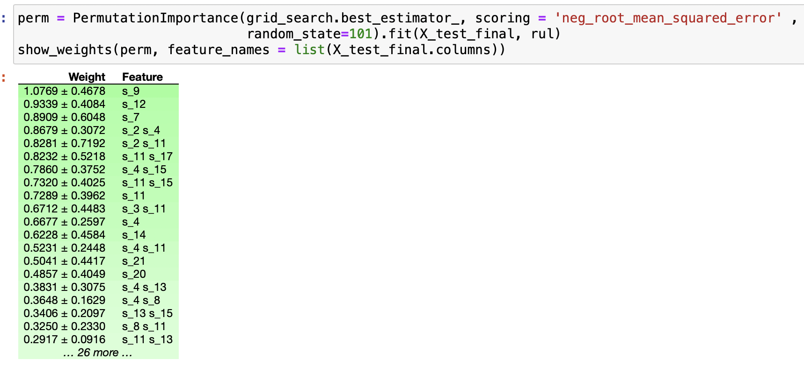
MODEL EXPLAINABILITY LIBRARIES: ELI-5

Slide 6
SUMMARY
TBD

